Slide 1
Town of Ellicott Police Department Police Reform and Reinvention Collaborative
Police Chief William L. Ohnmeiss Jr.
Town Supervisor Patrick W. McLaughlin

Slide 2
Executive Order 203 - Compliance
The Town must perform a comprehensive review of current Ellicott Police deployments, strategies, policies, procedures and practices.
Chief Executive officer of the Town is tasked to call together the Police Chief and stakeholders in the community to develop a plan for any needed improvements to current deployments, strategies, policies, procedures, and practices.
The plan shall be offered for public comment, and after consideration of such comments, shall be ratified by Resolution or adopted by Local Law, no later that April 1, 2021.
The Town shall transmit a certification to the Director of the Budget that the process has been complied with and the Resolution or Local Law has been adopted.

Slide 3
Executive Order 203 – Compliance & Considerations
Promote community engagement to foster trust, fairness, and legitimacy
Address any racial bias and disproportionate policing of communities of color
Evidenced based policing strategies
Use of Force Policies
Procedural Justice
Systemic racial bias in policing
Implicit bias training

Slide 4
Executive Order 203 – Compliance & Considerations
De-escalation training and practices
Law Enforcement assisted diversion programs
Restorative Justice practices
Community based outreach and conflict resolution
Problem oriented policing
Hot Spot policing
Focused deterrence

Slide 5
Executive Order 203 – Compliance & Considerations
Crime prevention through environmental design
Violence prevention and reduction interventions
Model policies and guidelines promulgated by the NYS Municipal Police Training Council
Standards promulgated by the New York State Law Enforcement Accreditation Program.

Slide 6
Mandatory Stakeholders
Members of local law enforcement
Interested non-profit and faith based community groups
Members of community, with emphasis in areas with high numbers of police and community interactions
District Attorney
Public Defender
Local Elected officials

Slide 7
Reform & Reinvention Collaboration Process: Community Meetings
Town-wide community meetings – primary discussions on racial disparity
Open Door Policy of Police Chief. Invitation to anyone in the public to discuss issues.
Multiple discussions with community leaders in one on one settings
Continued collaboration & meeting with Police Chiefs

Slide 8
Reform & Reinvention Collaboration Process: Community Meetings - Ellicott
Public Safety Council & Police Administration
Faith Based leaders and organizations
Mental Health providers & organizations
Elementary School representatives
Middle/High School Representatives
Social Service Providers & Non – Profit Organizations
Law Enforcement, Probation, District Attorney

Slide 9
Reform & Reinvention Collaboration Process: Stakeholder Survey (Appendix)
Surveys completed by stakeholders in Town of Ellicott and county fire service:
Lakewood-Busti
Jamestown
Chautauqua County Sheriff
Carroll
Fire Chiefs and Fire Coordinators throughout all fire districts in Town of Ellicott

Slide 10
Reform & Reinvention Collaboration Process: Community Survey (Appendix)
Survey presented to all residents of county through web site, Facebook page, local media, and delivering of hard copies

Slide 11
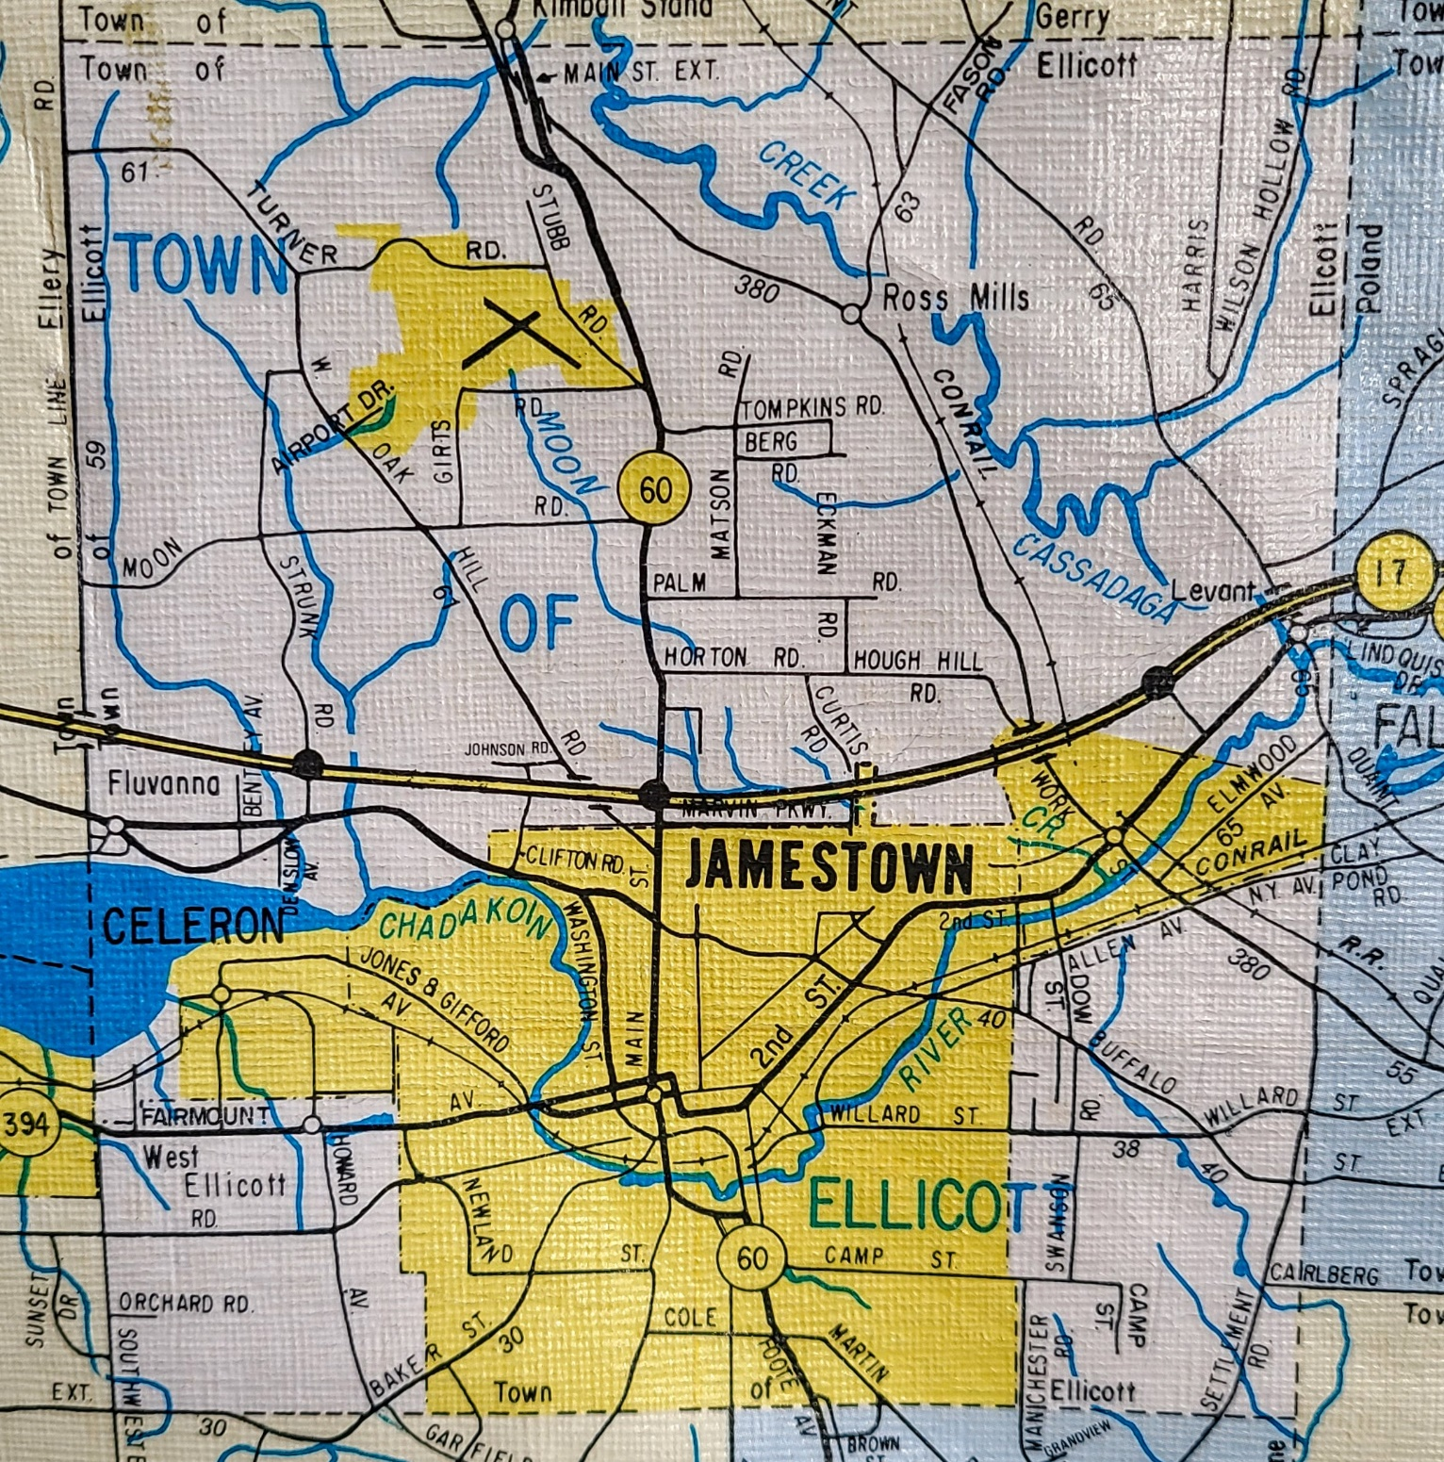

Slide 12
Town of Ellicott History
The Town of Ellicott was formed on June 1, 1812. It was one of the three Townships first formed within Chautauqua County. In 1886 the Village of Jamestown was incorporated as a City and became a Municipality separate from the Town of Ellicott. In 1891 Falconer was incorporated as a Village within the Township; - as was Celoron in 1896. As the Villages and Town became more populated and settled it was necessary to provide for the enforcement of the Laws and Ordinances that had been enacted to protect and preserve the rights of all. Each of the municipalities within Ellicott provided Law Enforcement individually. This practice was suitable to the circumstances. The total census was not large, it was dispersed in “pockets” with a very “less mobile” lifestyle; - and the City of Jamestown was the “hub” providing industry, mercantile, and other sources of supplies for the daily needs. Over a period of time an increased transience within the industrial, retail, and mercantile sector from this “hub” (either to mergers, distant locations, local suburban areas, or going out of business) changed the demographics, character, and relatively of the City, the Town, and the Villages to each other. Prior to 1968, Ellicott had part time Officers providing coverage on a part time basis within the Township outside of the Villages. Celoron had a similar setup for the Village, while the Village of Falconer had a full time Police Department. On March 20, 1968 the Town Board established a bona-fide Police Department pursuant to the provisions of section 150 of the N.Y.S. Town Law. On April 15, 1968 the position of Chief of Police was established pursuant to N.Y.S. Town Law, N.Y.S. General Municipal Law, and N.Y.S. Civil Service Law. Prior to 1980 there were 11 full time sworn Officers and 8 part time sworn Officers employed among the three respective jurisdictions of the Town of Ellicott. On 6/1/81 the Village of Celoron dissolved its’ Police Department and became a part of the constituency of the Town of Ellicott Police Department. On 6/20/83, by voter referendum, the Village of Falconer dissolved its’ Police Department and also became a part of the constituency of the Town of Ellicott Police Department. Currently we have 13 full-time Police Officers, 11 part time Police Officers. We maintain a 24/7 patrol; - via 2 or 3 patrol units on an east – west assignment basis. We continue to evaluate, adjust, and improve our service delivery to meet the ever-changing needs for Law Enforcement within the Town of Ellicott.

Slide 13
Town of Ellicott Demographics (2010 Census)
Approximately 31 square miles
Population approximately 8,700
97% Caucasian
.8% African American
1.3% Hispanic
.3% Asian
.9% Multi-race
.1% Native American

Slide 14
Agency Demographics – Law Enforcement
24 Sworn Employees
Chief of Police
First Sergeant
Sergeant
Detective
Patrol Officers (15)
School Resource Officers (4)
Drug Officer

Slide 15
Law Enforcement: Divisions
Patrol
Criminal Investigation
Court Security
Records
Juvenile
Training
Forensic Investigation Member’s
Detective

Slide 16
Law Enforcement: Special Teams
SWAT
Drug Task Force Members
Evidence and Property Manager
Fleet Maintenance
Internal Affairs
School Resource Officers – Falconer & Southwestern

Slide 17
Current deployments, strategies, policies, procedures and practices
12 Hour Patrol Shifts
2 Patrol units
Supervisor 1 per Shift
1 Detective – Hours as needed

Slide 18
Review of Policies
Deployment
Use of Force Policies
Procedural Justice
Racial bias
Implicit Bias
Vehicle and Traffic Policy
Stop and Frisk
* Department policy’s are available for public review upon request through the Chief of Police

Slide 19
Police Reform Survey
Wednesday, February 03, 2021

Slide 20
50 Total Responses
Date Created: Wednesday, November 25, 2020
Complete Responses: 50

Slide 21
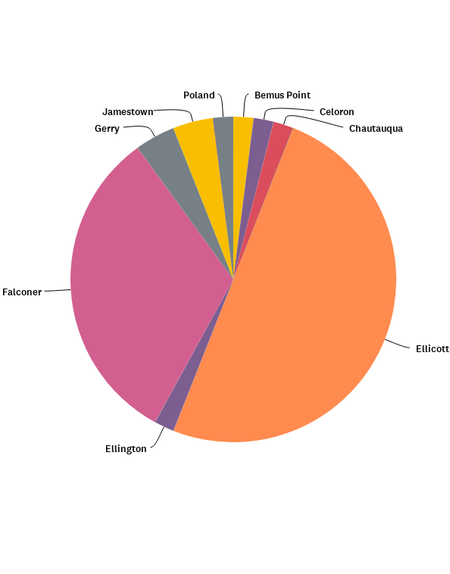
Q1: Please select the location of your residence or if you are not a resident the town of your employment
Answered: 50 Skipped: 0

Slide 22
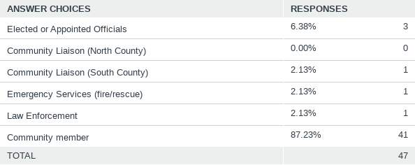
Q2: What stakeholder group do you belong to?
Answered: 47 Skipped: 3

Slide 23
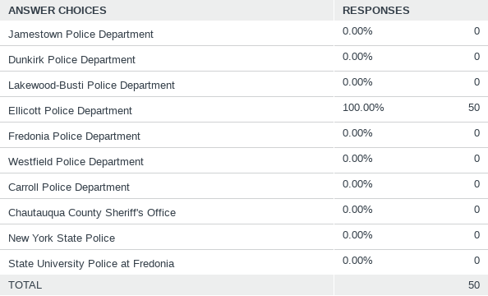
Q3: Please select local police department to provide feedback on
Answered: 50 Skipped: 0

Slide 24
Q4: When was the last time you had a direct interaction with your local police agency?
Answered: 50 Skipped: 0

Slide 25
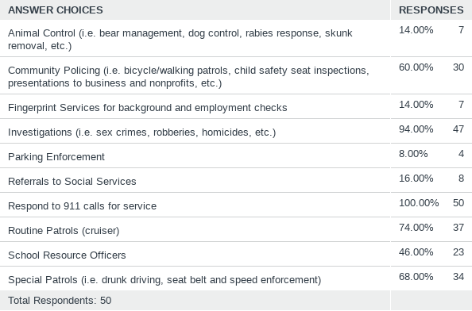
Q5: Please select the top 5 services that you think are most important for your police department to provide
Answered: 50 Skipped: 0

Slide 26
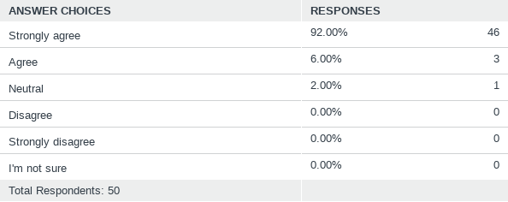
Q7: Police officers are a necessary part of your community
Answered: 50 Skipped: 0

Slide 27
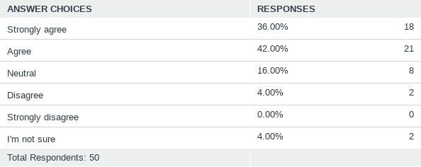
Q8: Police officers in your community are well trained.
Answered: 50 Skipped: 0

Slide 28
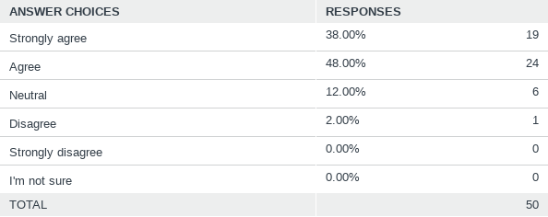
Q9: Police officers in your community are responsive to the public's needs.
Answered: 50 Skipped: 0

Slide 29
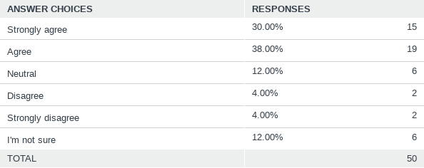
Q10: Police officers in your community are held accountable for their actions
Answered: 50 Skipped: 0

Slide 30
Q11: Police officers in your community strive to have a positive impact on the community
Answered: 50 Skipped: 0

Slide 31
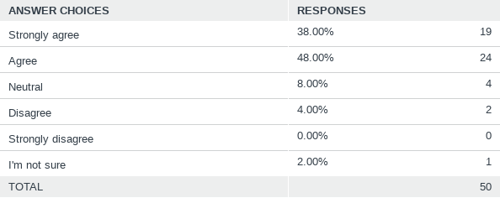
Q12: Police officers in your community are fundamentally honest
Answered: 50 Skipped: 0

Slide 32
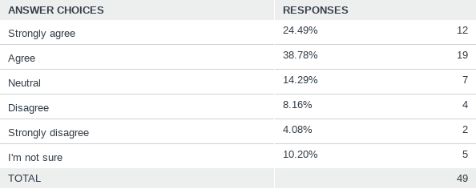
Q13: If you have a complaint against your local police department or an officer, you are confident it will be heard and reviewed objectively
Answered: 49 Skipped: 1

Slide 33
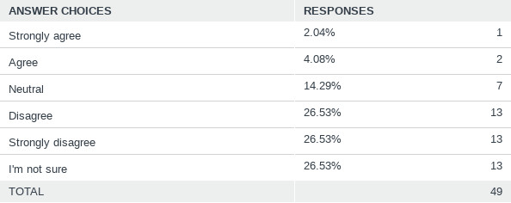
Q14: There is corruption in your police agency
Answered: 49 Skipped: 1

Slide 34
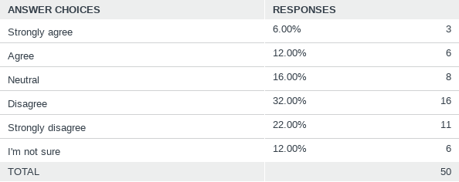
Q15: Police officers in your community are biased in their interactions with certain groups of people
Answered: 50 Skipped: 0

Slide 35
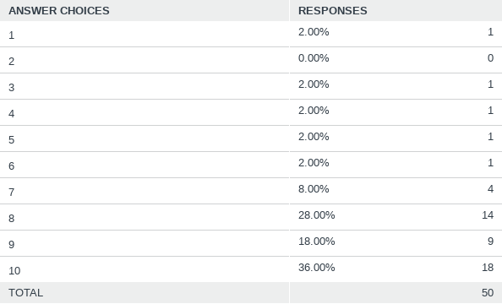
Q16: On a scale from 1 to 10, how satisfied are you with your police agency? (1 = Not at all satisfied, 10 = Extremely satisfied)
Answered: 50 Skipped: 0

Slide 36
Q18: 16. Gender Identity
Answered: 49 Skipped: 1

Slide 37
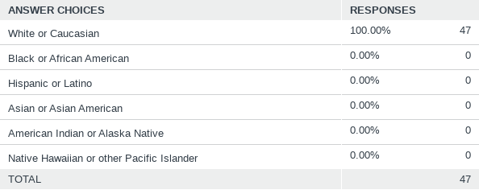
Q19: Race Identity
Answered: 47 Skipped: 3

Slide 38
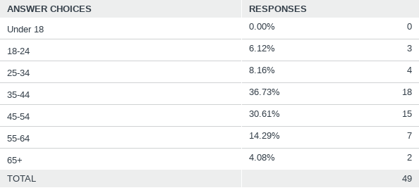
Q20: What is your age group?
Answered: 49 Skipped: 1

Slide 39
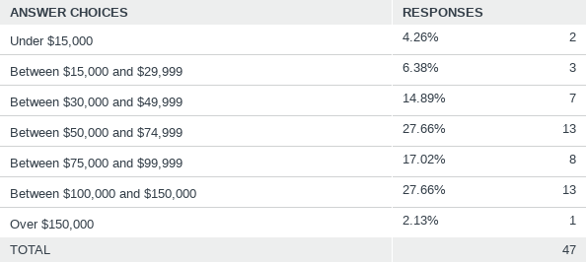
Q21: What is your household income?
Answered: 47 Skipped: 3

Slide 40
Survey Results Summarized
50 Respondents
82% contact with police in last 5 years
Stakeholder Groups
88% Community members
5% Emergency Services
3.5% Law Enforcement
2% Elected or Appointed Officials
1% Community Liaison

Slide 41
Top Five Services Desired
Respond to 911 Calls for service
Investigations (i.e. sex crimes, robberies, homicides, etc.)
Routine Patrols
Special Patrols (i.e. drunk driving, seat belt, speed enforcement)
Community Policing

Slide 42
Top Three Things to Improve Policing
Community Policing
Fair & unbiased policing, diversity training
Mental Health & de-escalation training

Slide 43
Community Beliefs of Law Enforcement
92% believe Law Enforcement are necessary in community
63% believe officers are well trained / 25% unsure or neutral
71% believe Law Enforcement are responsive to public needs
52% believe officers are held accountable for actions
71% believe officers have a positive impact on community

Slide 44
Community Beliefs of Law Enforcement
86% believe officers are fundamentally honest
63% believe complaints against police are heard and reviewed objectively
53% do not believe there is corruption in police 26% neutral/unsure
54% do not believe officers are biased, 18% believe there is bias
Nearly 82% are satisfied with police in community

Slide 45
Oath Of Honor
On my honor, I will never betray my integrity, my character, or the public trust.
I will treat all individuals with dignity and respect and ensure that my actions are dedicated to ensuring the safety of my community and the preservation of human life.
I will always have the courage to hold myself and others accountable for our actions.
I will always maintain the highest ethical standards and uphold the values of my community, and the agency I serve.

Slide 46
Ellicott Police strive to follow Procedural Justice and Peel’s Principles.
Procedural Justice is based on four basic principles.
1. Treating people with dignity and respect.
2. Giving citizens a voice during encounters.
3. Being impartial/neutral in decision making.
4. Conveying trustworthy motives, transparency in action.

Slide 47
Peel’s Principles of Policing – past & present
The basic for which the police exists to prevent crime and disorder.
The ability of the police to perform their duties is dependent upon the public approval of police actions.
Police must secure the willing co-operation of the public in voluntary observation of the law to be able to secure and maintain the respect of the public.
The degree of cooperation of the public that can be secured diminishes proportionately to the necessity of the use of physical force.

Slide 48
Peel’s Principles of Policing – past & present
Police seek and preserve favor not by catering to public opinion, but by constantly demonstrating absolute impartial service to the law.
Police use physical force to the extent necessary to secure observance of the law or to restore order only when the exercise of persuasion, advice, and warning is found to be insufficient.
Police, at all times, should maintain a relationship with the public that gives reality to the historic tradition that the police are the public and the public are the police; the police being only members of the public who are paid to give full time attention to duties which are incumbent upon every citizen in the interests of community welfare and existence.

Slide 49
Peel’s Principles of Policing – past & present
Police should always direct their action strictly towards their functions, and never appear to usurp the powers of the judiciary.
The test of police efficiency is the absence of crime and disorder, not the visible evidence of police action in dealing with it.

Slide 50
Objectives and Training to be Obtained
Principled Policing – procedural justice, implicit bias, transparency, de-escalation
Outward Mindset – communication, de-escalation, community relationship development
Character Based Policing – supervisors
Crisis Intervention Team Training – mental health
Trauma Informed Policing

Slide 51
Future Goals and Objectives
Continued review and training in previous listed courses
Community Involvement –community stakeholder meetings – determine the needs of in various parts of the Township
Collaboration with Mental Hygiene to develop a robust mobile crisis response team – goal of a 24/7 operation
Develop a better Public Safety Model of Policing – Coactive Policing (working with community to solve problems) rather than reactive or proactive
Customer Satisfaction surveys

Slide 52
Future Goals and Objectives
Diversion : PAARI or L.E.A.D.
Community L.O.V.E. Gardens
Learning about Each other
Opening our hearts to each other
Volunteering to be part of solution
Empowering others to do the same

Slide 53
Future Goals and Objectives
Peer Support for all staff
Wellness Initiative for all staff
Restorative Justice (planning underway for youth, goal for adults also)
Focused Deterrence / “Pulling-levers” – specifically for drug enforcement – partner with social service, community partners and all police agencies.
Crime prevention through Environmental Design

Slide 54
Potential Obstacles to Change
Anti-Intellectualism
Violence
Corruption
Discourtesy
Fiscal Restraints
Time Restraints

Slide 55
Seven Improvement Steps: Envision
We must cast a bold and breathtaking vision to ensure a distinguished future for policing.
Integrity
Courage
Character
Unconditional Respect

Slide 56
Seven Improvement Steps: Select
Police must encourage and select the best and the brightest to serve as police officers.
Improve Recruitment
Police force that represents community

Slide 57
Seven Improvement Steps: Listen
Police leaders must listen to their officers and members of the community.
Regular meetings with staff/officers
Regular community meetings – active listening

Slide 58
Seven Improvement Steps: Train and Lead
Police leaders must implement professional training and a collaborative leadership style.
Utilize various disciplines to assist training
Collaborate with social service and non-profit organizations

Slide 59
Seven Improvement Steps: Improve Continuously
Police must unceasingly improve the systems in which they work – everything we do.

Slide 60
Seven Improvement Steps: Evaluate
Police must be able to critically assess, or have assessed, the crucial tasks and functions they are expected to perform.

Slide 61
Seven Improvement Steps: Sustain
Police leaders must be able to maintain and continue improvements to their organization.

